Slide 1

Berkeley Data analysis Project one Team : D
Ran Bi
Shuai LI
Justin Agogbua

Slide 2
Hypothesis
Area’s with Higher median housing prices are like vortexes in the bay area, they pull in people and business’s into their center
What type of businesses are more prevalent in the most expensive areas?
We explored this by looking at median housing prices and populations by zip code and comparing business concentration around the bay area
Do large groups of people commute to area’s with higher housing ?
We also looked at expected traffic between counties during morning and evening peek and off peek hours.
Notes:
Chicken and a egg philosophy comes in here, what came first the center of business/interest or the high housing prices.

Slide 3
What we found
There seems to be some correlation with high housing prices and populations vs. the concentrations of business
With the data sets we used it is unclear if the businesses drove the prices up or vice versa
There also seems to be more time spent in traffic during commuter hours headed towards area’s with higher housing prices rather then away
Traffic data was based upon county’s which can be financially different depending on where you live in them
Populations more relate to the concentrations of business types

Slide 4

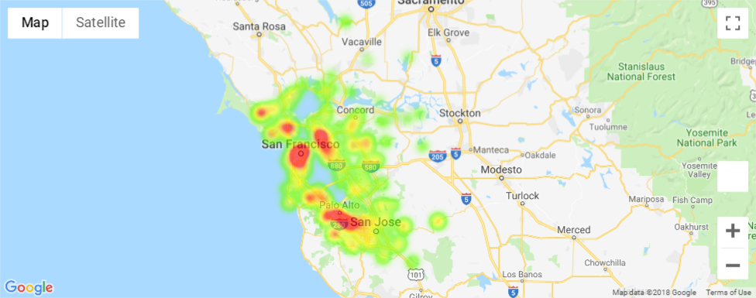
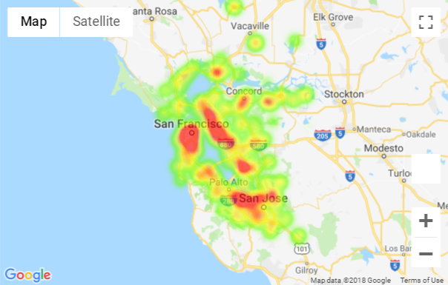
Housing Price vs Population heat map

Slide 5
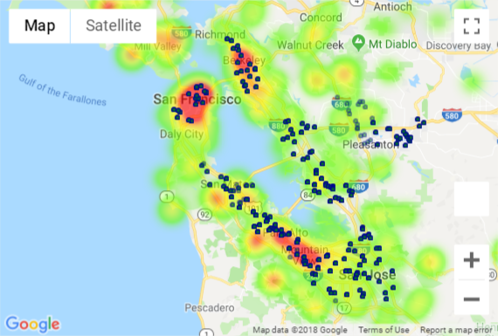
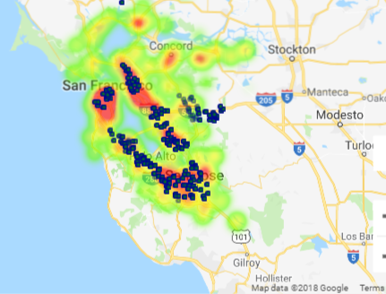
School with Population Heatmap
School with housing price Heatmap
VS
School locations are more relate to Population

Slide 6
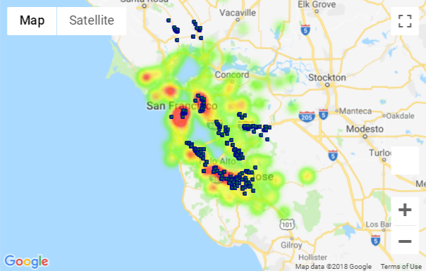
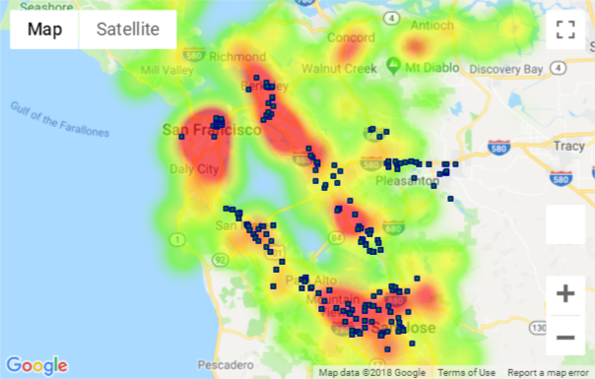
restaurant with Population Heatmap
restaurant with housing price Heatmap
VS
Restaurant locations are also more relate to Population

Slide 7
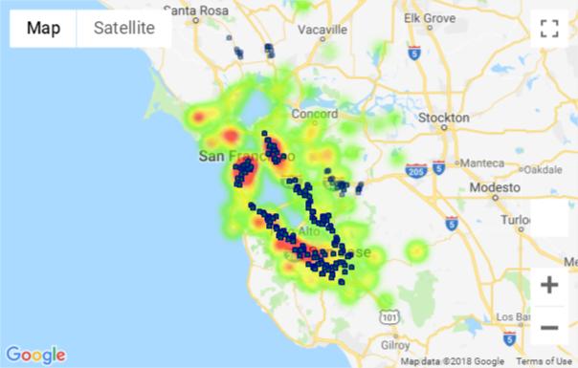
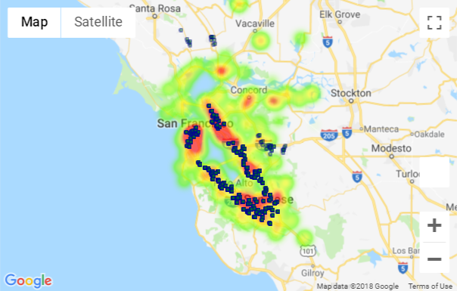
Supermarket with Population Heatmap
Supermarket with housing price Heatmap
VS
Supermarket locations are more relate to Population

Slide 8
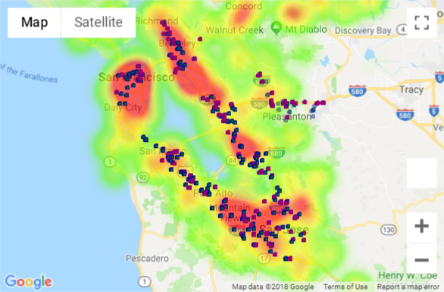
supermarket & department store on population heat map (Blue dot) (Red dot)
Similar types stores have similar distributions

Slide 9
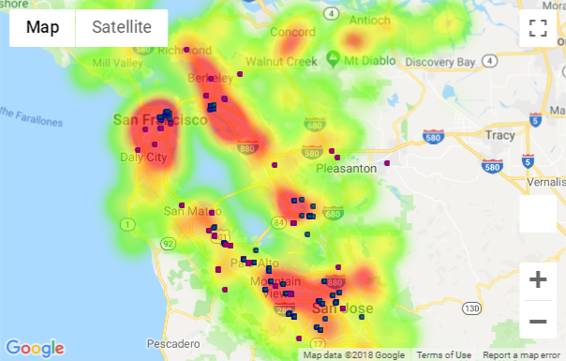
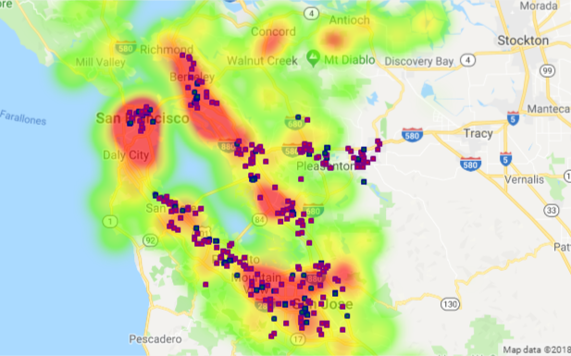
Government buildings(blue) and City hill(red) on population heatmap
More Graphs just for fun !
Hospital(blue) and Church(red) on population heatmap

Slide 10
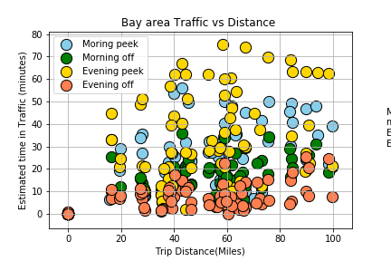
Expected time in traffic

Slide 11
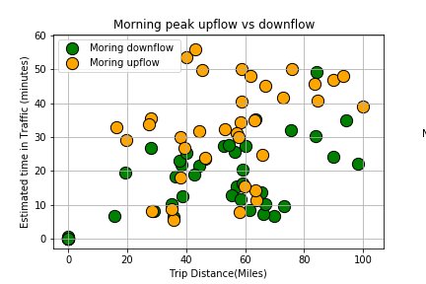
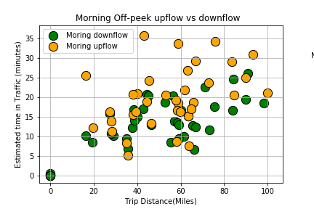
Morning up flow vs downflow commute

Slide 12
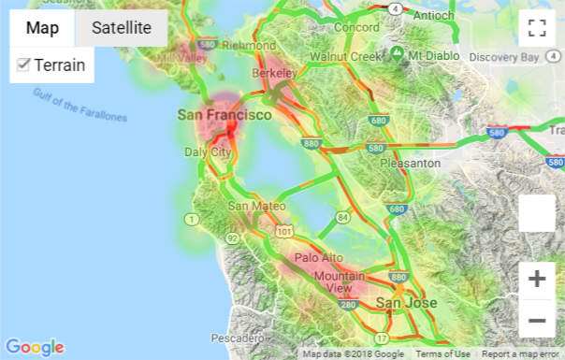
Peek morning traffic vs housing prices

Slide 13
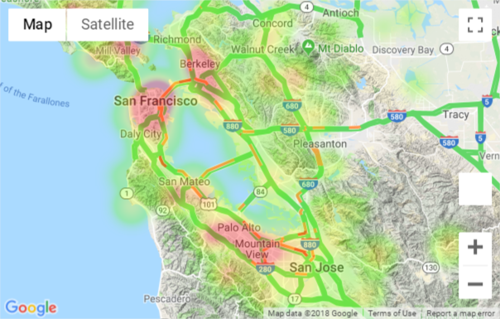
Off peak morning traffic vs housing prices

Slide 14
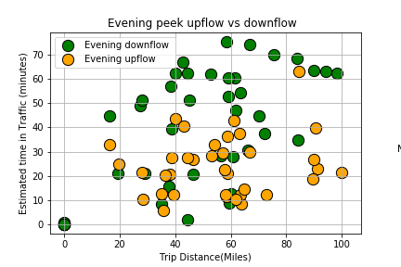
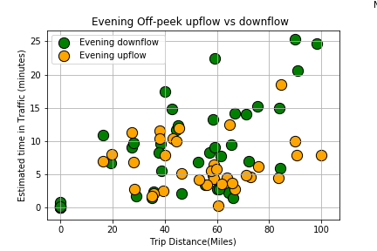
Evening up flow vs downflow commute

Slide 15
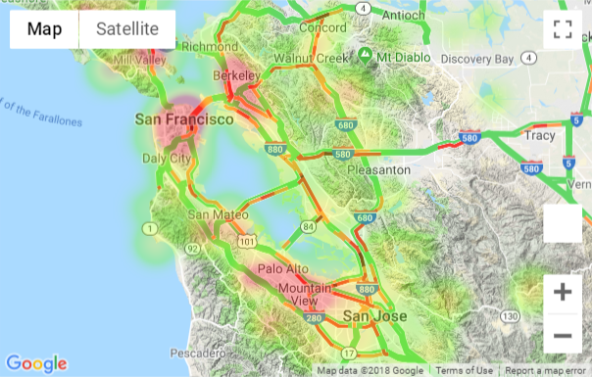
Peek Evening Traffic vs housing prices

Slide 16

Off-peak Evening traffic vs housing prices

Slide 17
Conclusion and considerations
We were looking predominately at correlation not causation
Our data is mostly snapshot data, it is predominantly built on a single point in time
We had limits on the amount of location data we could pull, so some of our data is samples rather then the whole picture
Zillowpy don’t allow pulling house price data only input zipcode
Google places have 60 data pulling limitation per city for each type of building

